Slide 1
Docker
Day 2

Slide 2
Docker Commands
Command | Description
docker info | Print System Information
docker Version | Version Information (CE/EE)
docker images | List all available images
docker ps | List all active containers
docker ps –a | List all containers (Including stopped ones)
docker run | Create and Start new container
docker start | Start a previously stopped container
docker stop | Stop the running container
docker rm | Remote a Stopped container
docker rmi | Remove an Image (Not linked to any container)
docker exec | Attach to running container (Helps in Debugging)

Slide 3
Additional Commands
Command | Description
docker logs {CONTAINER-NAME} | Print all logs
docker top {CONTAINER-NAME} | List all processes within container
docker commit | Capture existing container and create an image
docker build | Using Docker file, create new container image

Slide 4
Multi Container Applications
“Docker-Compose” is an additional utility which uses YAML files to configure and run multi-container applications.
The directory structure SHOULD BE:
\Application Root\docker-compose.yml
\Application Root\projectname.sln

Slide 5
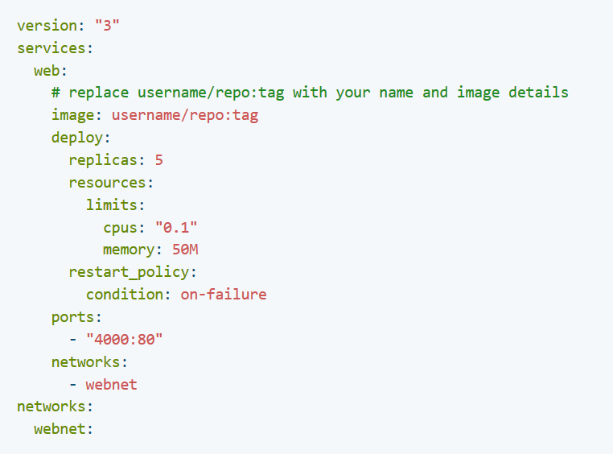
Docker Compose Syntax:

Slide 6
Docker Compose Elements
Element | Description
version: “3” | Docker Compose Version (Must be supported by docker-compose.exe version)
services: | List of services (Top Level Element)
<User Defined Service Name> | Must be direct child of “services” element
Image: | Complete Image name (Part of User defined service)
Deploy: | Deployment Parameters (OPTIONAL) (Part of User Defined Service)
Replicas: | Number of Instances (Part of “Deploy”)
Resources: | Limits on CPU / Memory (Part of Deploy)
Ports: | Ports Mapping (Part of User defined service)
Networks: | As Top Level Element to define new Network, As part of User defined Service to add reference.

Slide 7
Docker Secrets
Password
Encrypted Tokens / Hashes
Digital Certs
SSL Keys
Any thing that must NOT be visible in your docker-compose file.
Secrets are available only in SWARM mode

Slide 8
Creating a Secret
$ docker secret create <SecretName> <file>
Example:
$ docker secret create dbpass ./db.password

Slide 9
Adding reference to secret
In docker-compose
Create a Top Level element:
Secrets:
external: dbpass
Inject the secret in environment variable:
environment:
dbpassword: ${dbpass}

